Slide 1
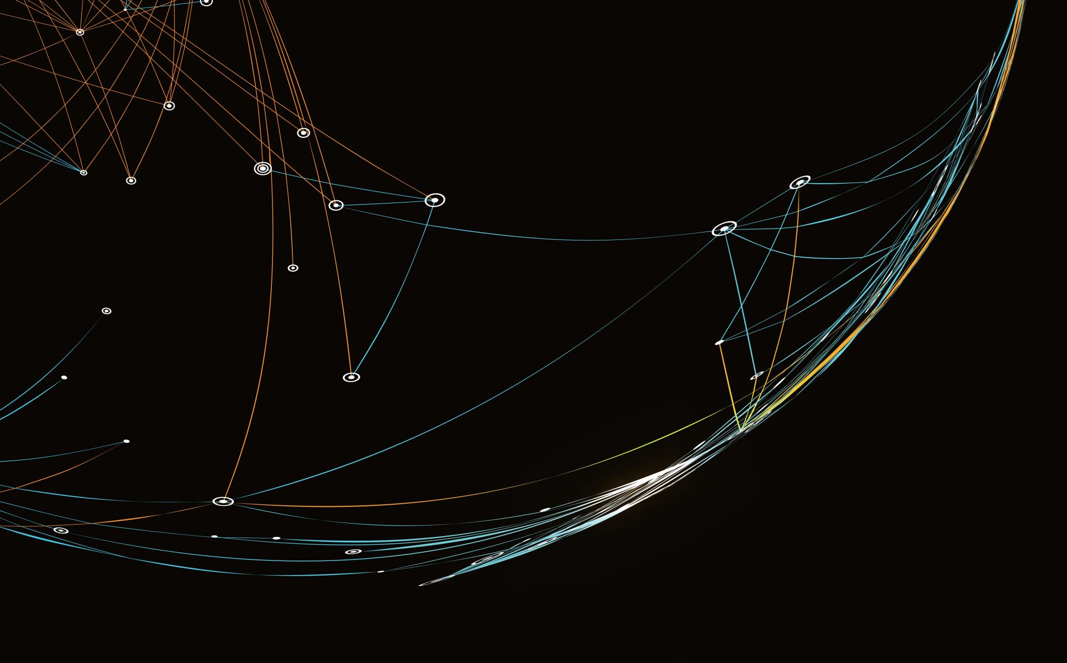
Global Activism
August 2021

Slide 2
Activists List
Atlantic Investment Management
Blue Harbour Group
Bulldog Investors
Carl Icahn
Cevian Capital
Corvex Management LP
Elevation Capital
Elliott Management
Engaged Capital
Greenlight Capital, Inc.
JANA Partners
Land and Buildings
Marcato Capital Management
Oasis Management Company (Oasis Capital)
Pershing Square Capital Management
Prescience Point Capital Management
Raging Capital Management
Relational Investors
Sachem Head Capital Management
Sarissa Capital Management
Southeastern Asset Management
SpringOwl Asset Management
Starboard Value
Steel Partners Holdings L.P.
Taconic Capital Advisors
The Children's Investment Fund Management (TCI)
Third Point Partners
Trian Fund Management
ValueAct Capital Partners

Slide 3
2015-2017
Min. 6 Campaigns

Slide 4
2015-2017 – השוואת אקטיביסטים

Slide 5
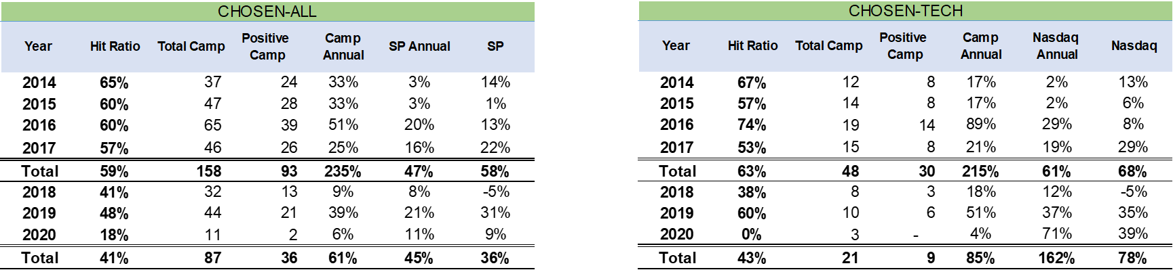
2014-2017
Min. 6 Campaigns

Slide 6
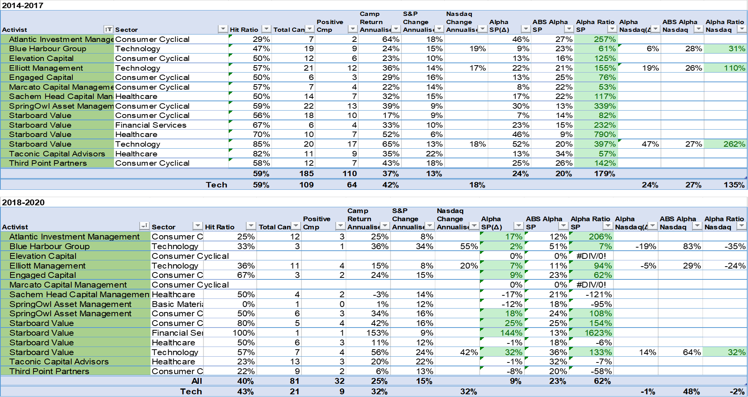
2014-2017 - Activists

Slide 7
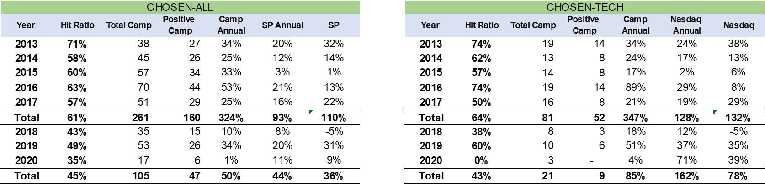
2013-2017
Min. 8 Campaigns

Slide 8
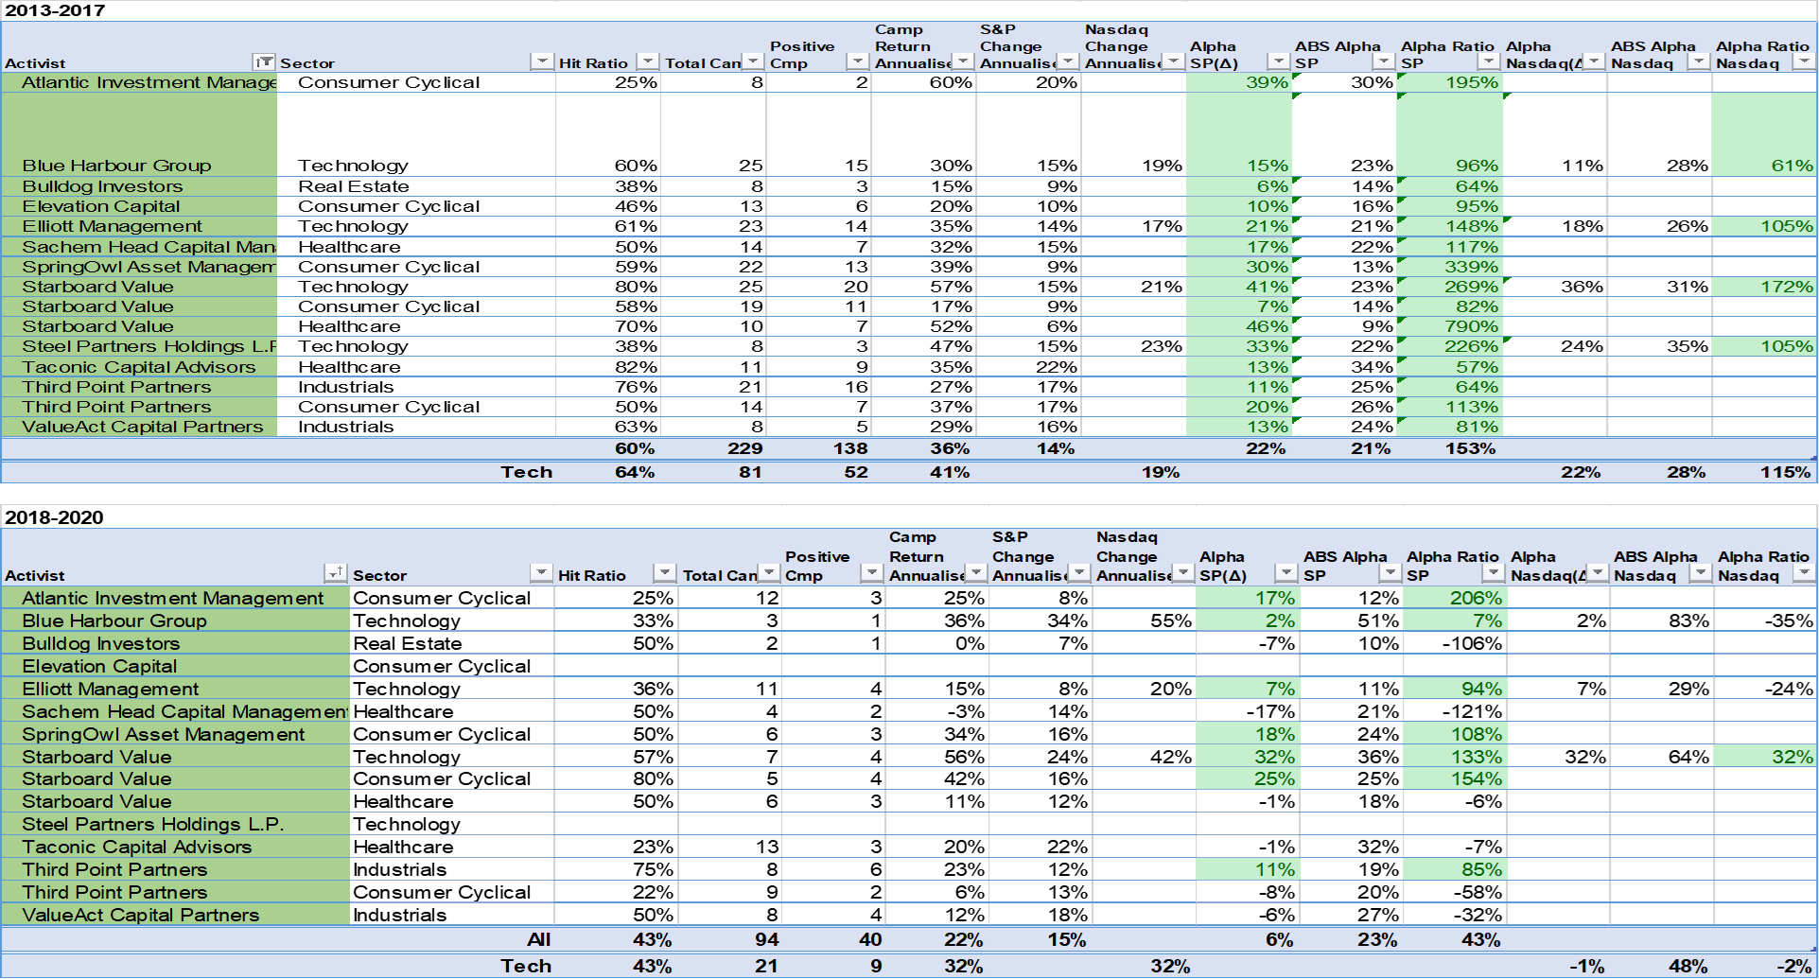
2013-2017 - Activists

Slide 9
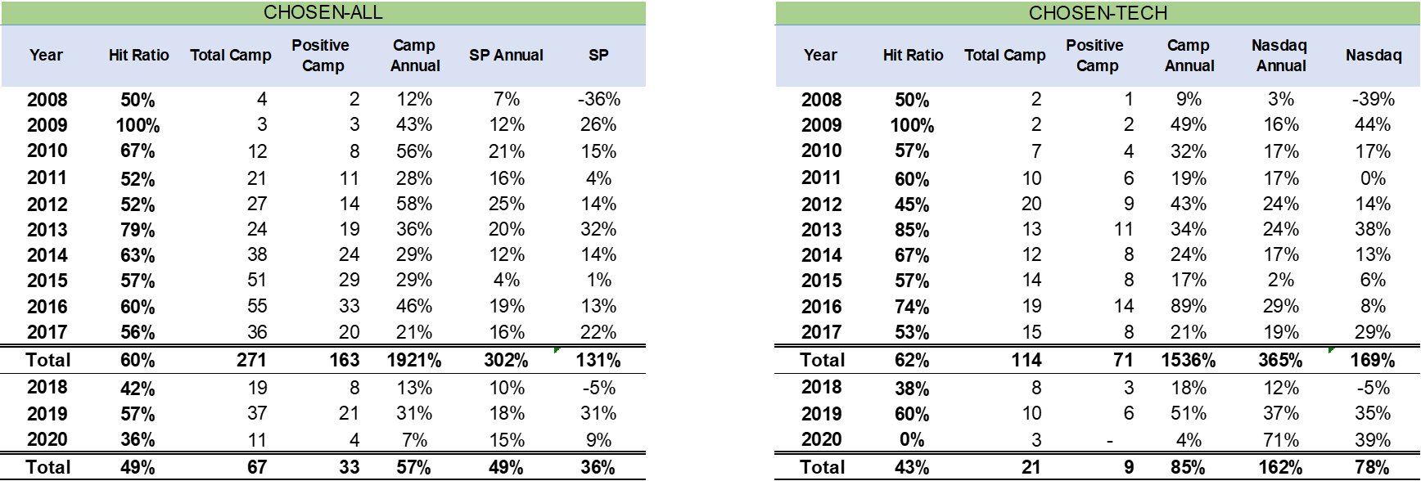
2008-2017
Min. 12 Campaigns

Slide 10
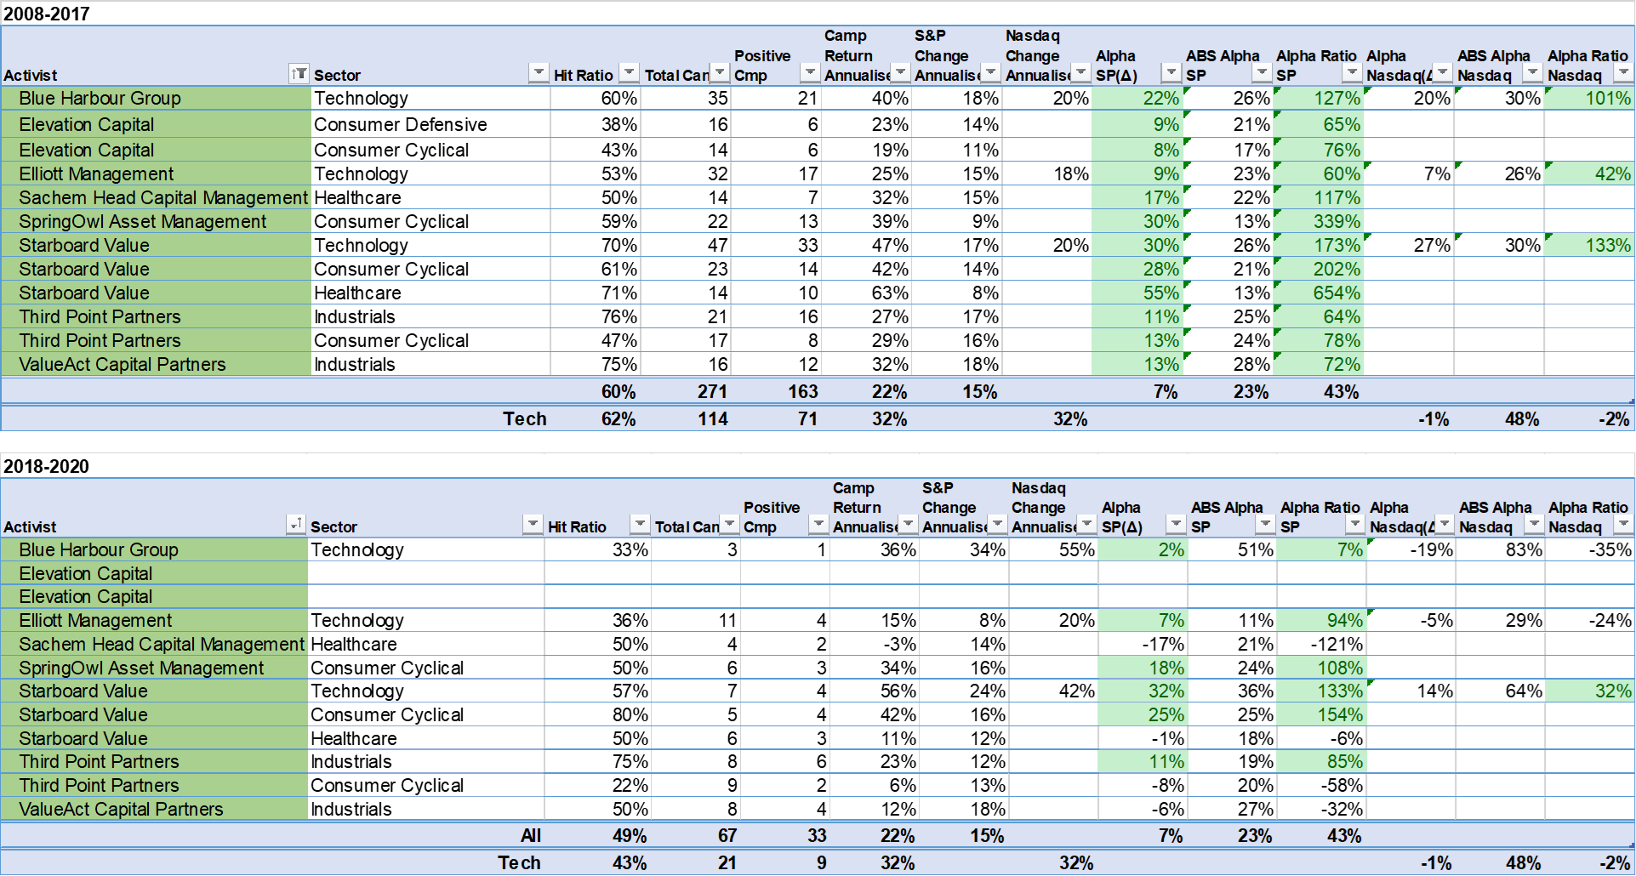
2008-2017 - Activists

